Slide 1
Market Basket Analysis
Prof .Sarika Patil

Slide 2
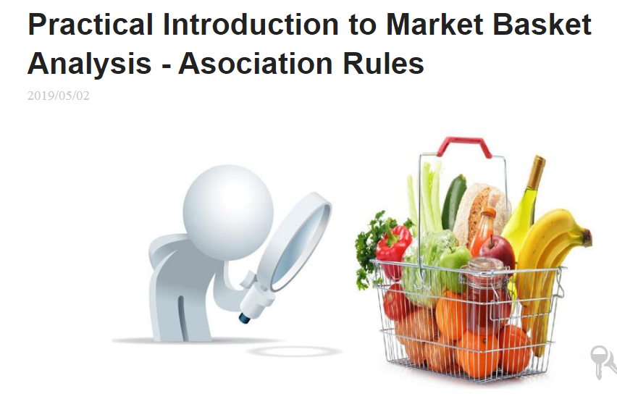

Slide 3
Market Basket Analysis is one of the key techniques used by large retailers to uncover associations between items. It works by looking for combinations of items that occur together frequently in transactions. To put it another way, it allows retailers to identify relationships between the items that people buy.
Association Rules are widely used to analyze retail basket or transaction data, and are intended to identify strong rules discovered in transaction data using measures of interestingness, based on the concept of strong rules.

Slide 4
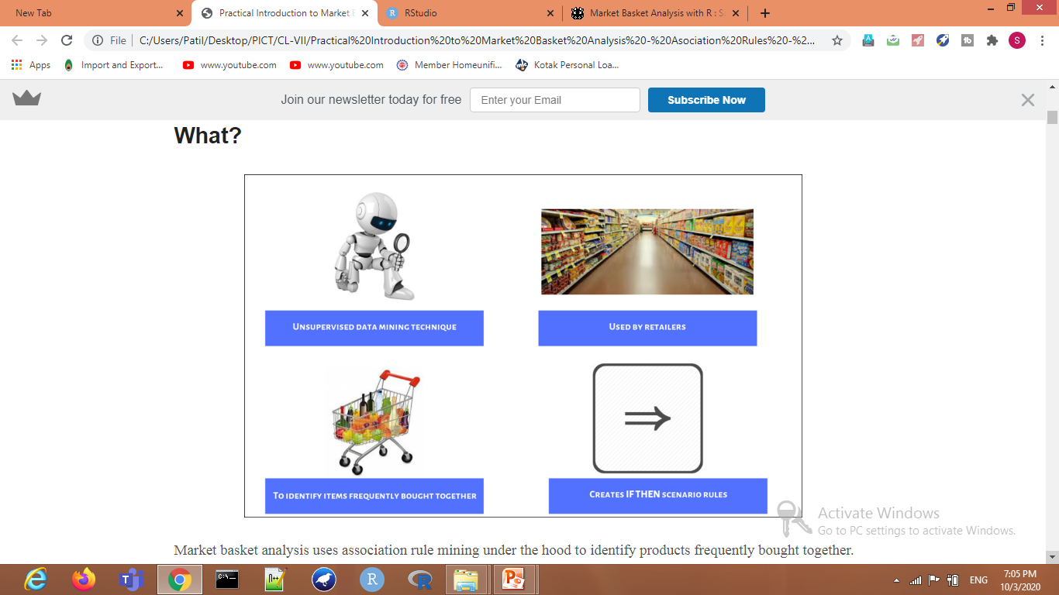

Slide 5
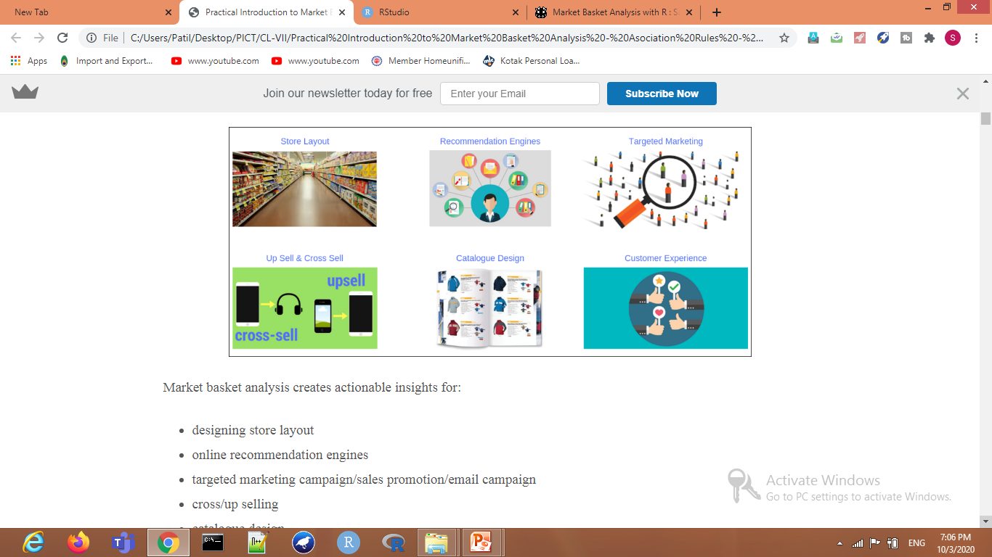

Slide 6
Applications
So what kind of items are we talking about? There are many applications of association:
Product recommendation – like Amazon’s “customers who bought that, also bought this”
Music recommendations – like Last FM’s artist recommendations
Medical diagnosis – like with diabetes
Content optimization – like in magazine websites or blogs
What are the trending items customers buy
Customized emails with add-on sales

Slide 7
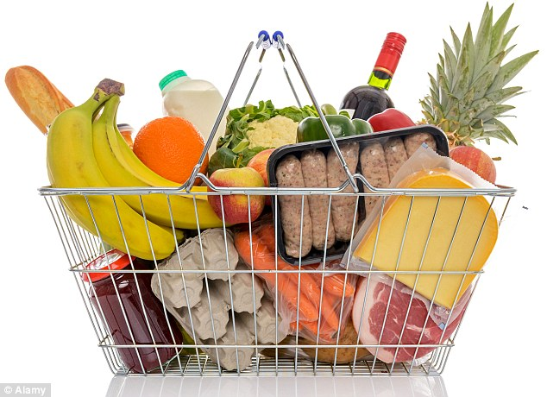
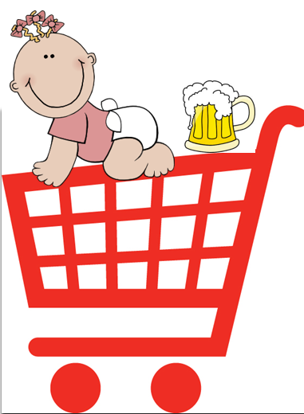
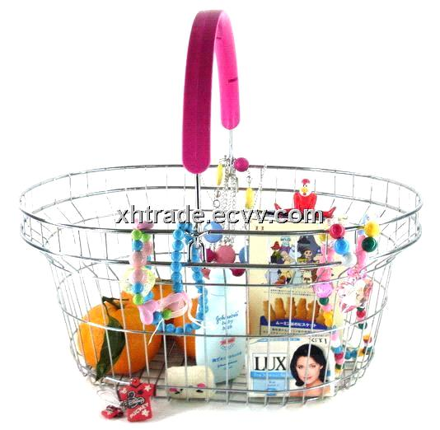
`Basket data’

Slide 8
ID apples, beer, cheese, dates, eggs, fish, glue, honey, ice-cream
1 | 1 | 1 |  | 1 |  |  | 1 | 1
2 |  |  | 1 | 1 | 1
3 |  | 1 | 1 |  |  | 1
4 |  | 1 |  |  |  | 1 |  |  | 1
5 |  |  |  |  | 1 |  | 1
6 |  |  |  |  |  | 1 |  |  | 1
7 | 1 |  |  | 1 |  |  |  | 1
8 |  |  |  |  |  | 1 |  |  | 1
9 |  |  | 1 |  | 1
10 |  | 1 |  |  |  |  | 1
11 |  |  |  |  | 1 |  | 1
12 | 1
13 |  |  | 1 |  |  | 1
14 |  |  | 1 |  |  | 1
15 |  |  |  |  |  |  |  | 1 | 1
16 |  |  |  | 1
17 | 1 |  |  |  |  | 1
18 | 1 | 1 | 1 | 1 |  |  |  | 1
19 | 1 | 1 |  | 1 |  |  | 1 | 1
20 |  |  |  |  | 1

Slide 9
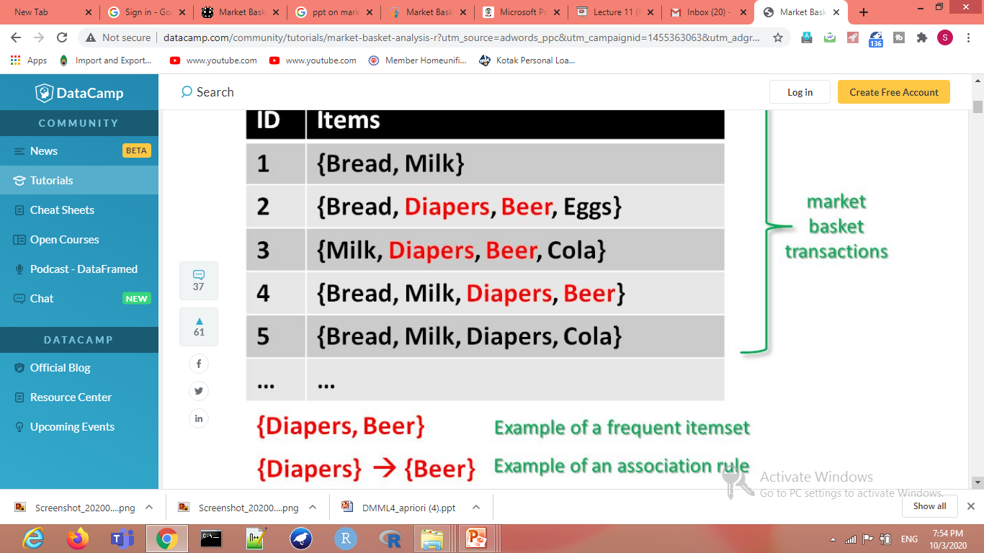

Slide 10
Apriori Algorithm
Prerequisite – Frequent Item set in Data set (AssociationRuleMining) Apriori algorithm is given by R. Agrawal and R. Srikant in 1994 for finding frequent itemsets in a dataset for boolean association rule. Name of the algorithm is Apriori because it uses prior knowledge of frequent itemset properties. We apply an iterative approach or level-wise search where k-frequent itemsets are used to find k+1 itemsets.
To improve the efficiency of level-wise generation of frequent itemsets, an important property is used called Apriori property which helps by reducing the search space.

Slide 11
Association Rule Mining
Association Rule Mining is used when you want to find an association between different objects in a set, find frequent patterns in a transaction database, relational databases or any other information repository.
The applications of Association Rule Mining are found in Marketing, Basket Data Analysis (or Market Basket Analysis) in retailing, clustering and classification. It can tell you what items do customers frequently buy together by generating a set of rules called Association Rules. In simple words, it gives you output as rules in form if this then that

Slide 12
Association Rule Mining is viewed as a two-step approach:
Frequent Itemset Generation: Find all frequent item-sets with support >= pre-determined min_support count
Rule Generation: List all Association Rules from frequent item-sets. Calculate Support and Confidence for all rules. Prune rules that fail min_support and min_confidence thresholds.
Frequent Itemset Generation is the most computationally expensive step because it requires a full database scan.
Above you have seen the example of only 5 transactions, but in real-world transaction data for retail can exceed up to GB s and TBs of data for which an optimized algorithm is needed to prune out Item-sets that will not help in later steps. For this APRIORI Algorithm is used

Slide 13
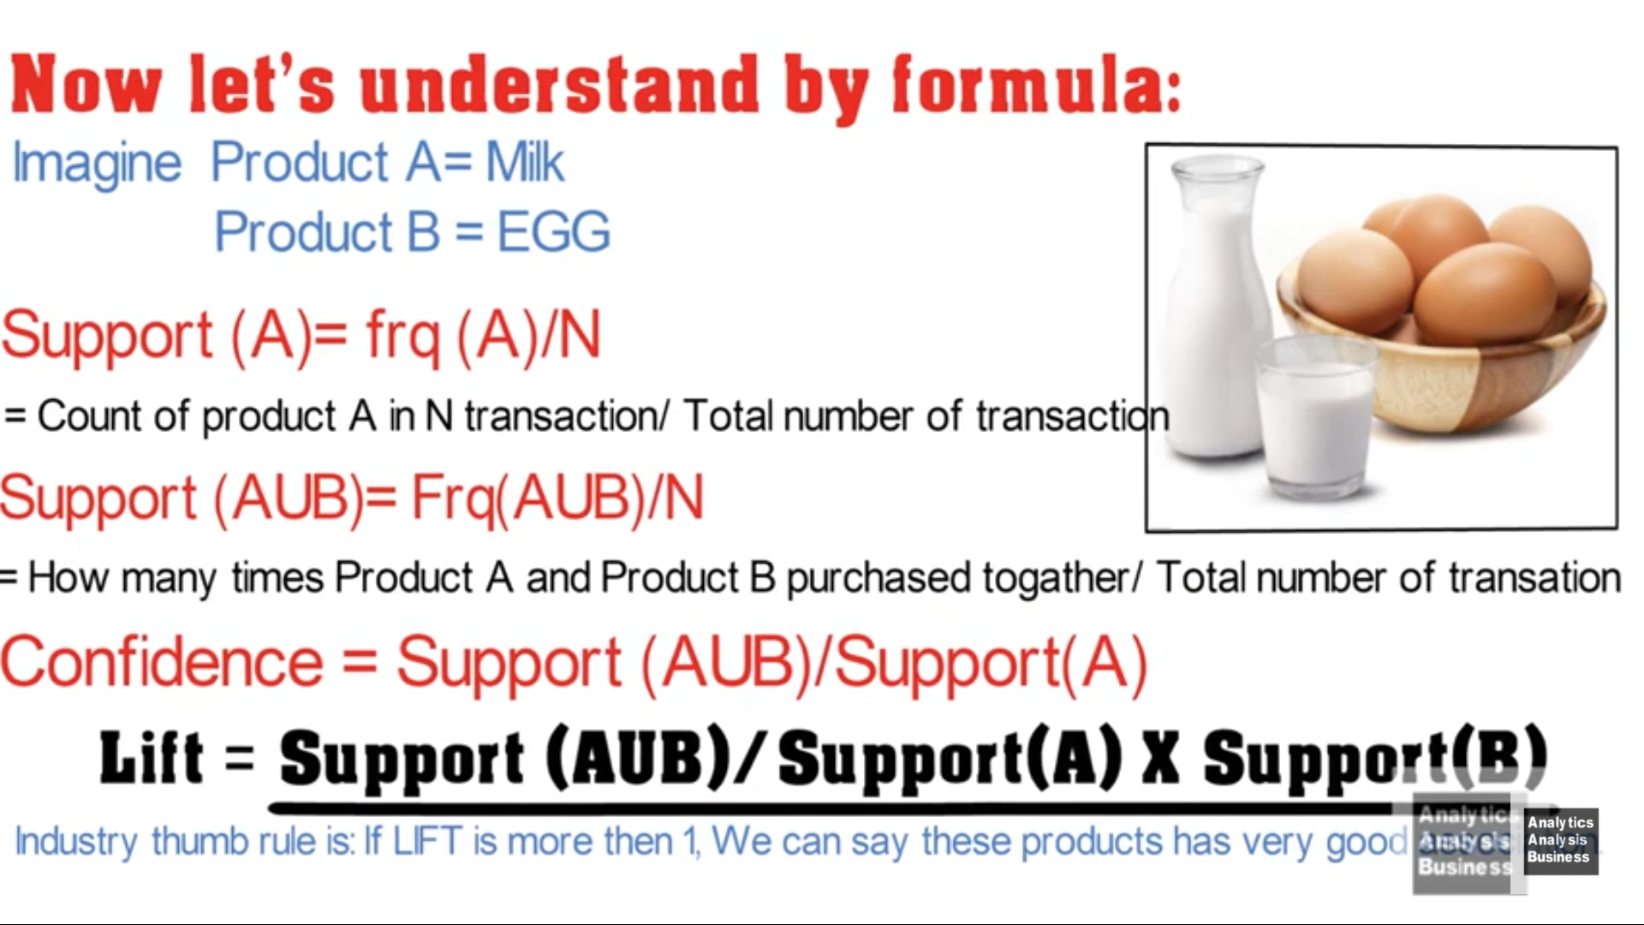

Slide 14
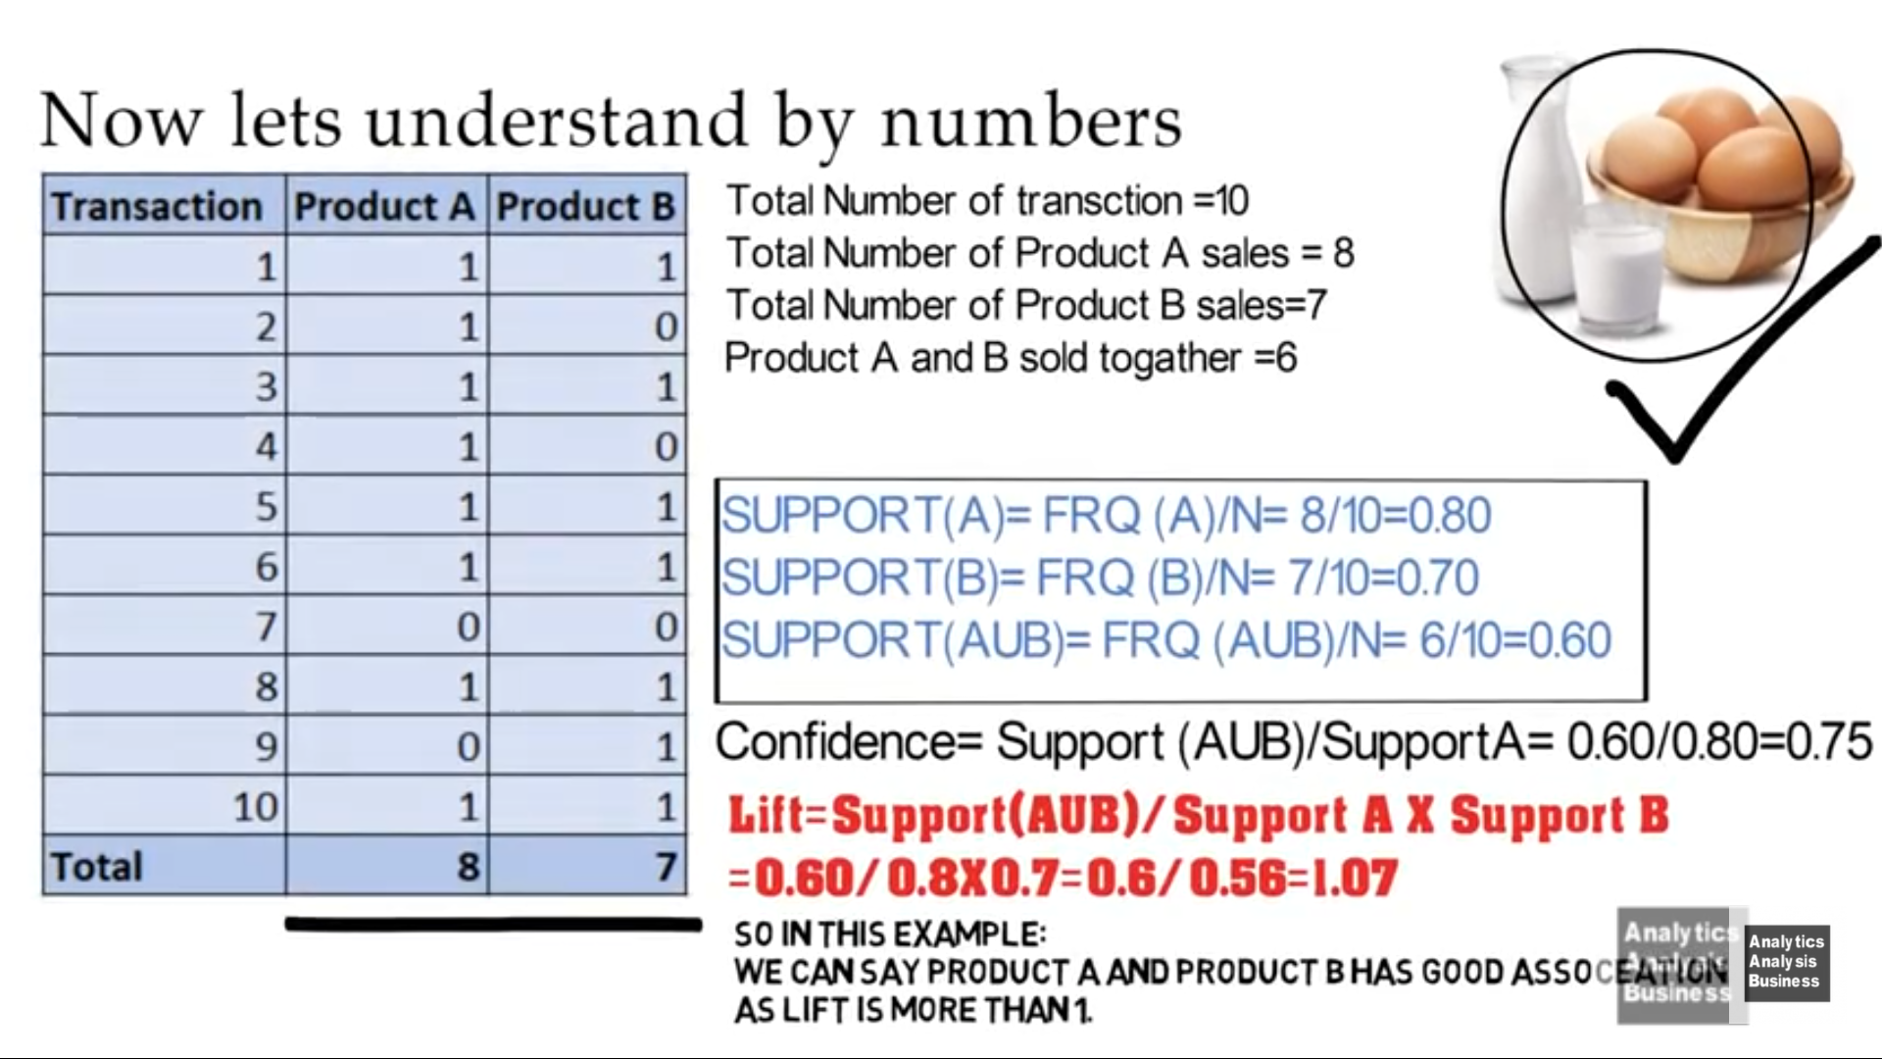

Slide 15
Lift Condition
If the rule had a lift of 1,then A and B are independent and no rule can be derived from them.
If the lift is > 1, then A and B are dependent on each other, and the degree of which is given by lift value.
If the lift is < 1, then presence of A will have negative effect on B.

Slide 16
Goal of Association Rule Mining
When you apply Association Rule Mining on a given set of transactions T your goal will be to find all rules with:
Support greater than or equal to min_support
Confidence greater than or equal to min_confidence

Slide 17
For any market basket analysis with Apriori algorithm, you need to consider three measures,
1- Support : Suppose you have 6000 records and want to fetch any item which is picked thrice in a day and you are containing the data of a week.
(3*7) / 6000 = 0.003
support = 0.003
2- Confidence : Let’s Assume you start with confidence = 80 % i.e
confidence = 0.8
3- Lift = Confidence/Support
Note : Lift is the key you should look up to.
Now try to find rules by using apriori function.
rules <- apriori(data = dataset, parameter = list(support = 0.003, confidence = 0.8))

Slide 18
Fixing Support and Confidence Values
There is no definite rule to fix a value. It is advice to keep a fair balance of support and confidence value to get appropriate/new rules Suppose you set a very high value, in that case you might get very less/ no rules and you might miss a few rules that you have wanted to see.

